Slide 1
GE120 Programming Project Plan
By: Jeremiah L. Marimon

Slide 2
The GE WidGEts
Project title:

Slide 3
General Description of the Project
The project is mainly a GUI application consisting of 3 widgets that the user can tinker around. The functionality of the three widgets are based on the lessons of first year geodetic engineering students.
The first widget is the Compass and Transit Rule widget that allows the user to input distances and azimuths and it automatically shows the latitude, departure, corrected latitude, corrected departure, corrected distances, corrected azimuths, LEC and the REC. The user can opt to import a csv file containing the required input. After that, the user can also click the export button to export the csv file containing the calculations. New functionality include the user specifying how many decimal places estimated.
The second widget is the Lot Technical Description widget that allows the user to input coordinates of the lot and it will give the technical description of the lot as well as the plot of the lot. The user can also choose to export the csv file containing the technical description.

Slide 4
General Description of the Project
The third widget is the Plot to Google Earth widget that allows the user to import a csv file containing the corners of a lost in WGS84 coordinates and in decimal degrees and plots the points and lines of the plot. It exports a kml file which can be opened on google earth. The restriction is that the coordinates must be strictly referenced to WGS84 and in decimal degrees.

Slide 5
Final Flowchart
- Visualization
-Export csv file button
Creation of the Compass and Transit Rule widget
-Main button
Radio button for Compass rule
Radio button for Transit Rule
-Input button
-Import csv file button
Main GUI window
- Visualization
-Export csv file button
-Main button
-Import csv file button
-Input coordinates button
Creation of the Lot Technical Description widget
Creation of the Plot to Google Earth Widget
Import csv file button
Export google earth kml file

Slide 6
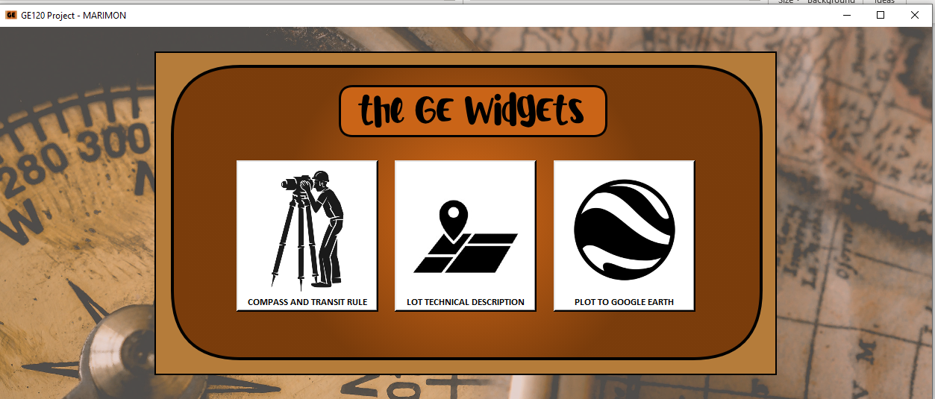
Sample Screenshots

Slide 7
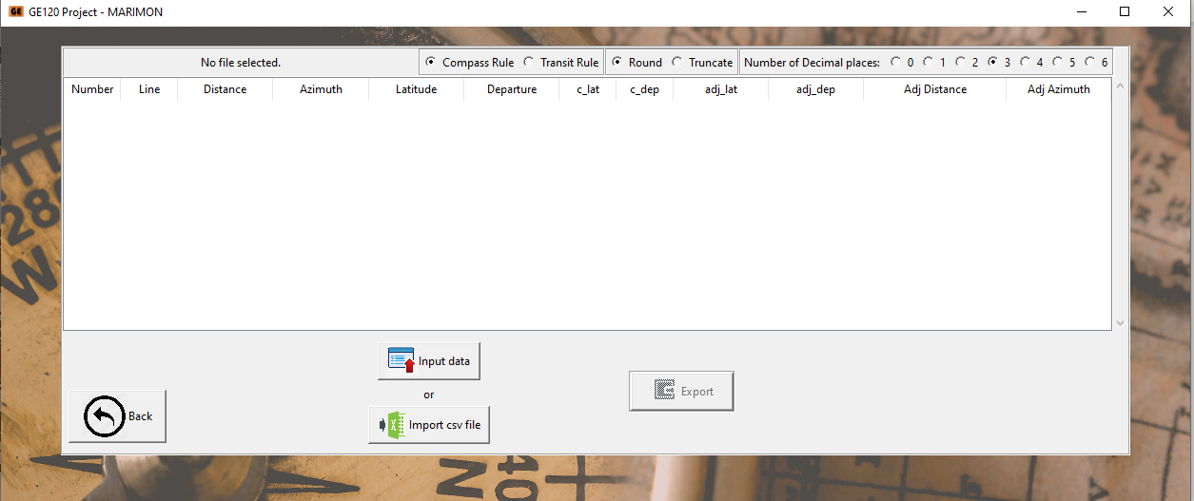
Sample Screenshots

Slide 8
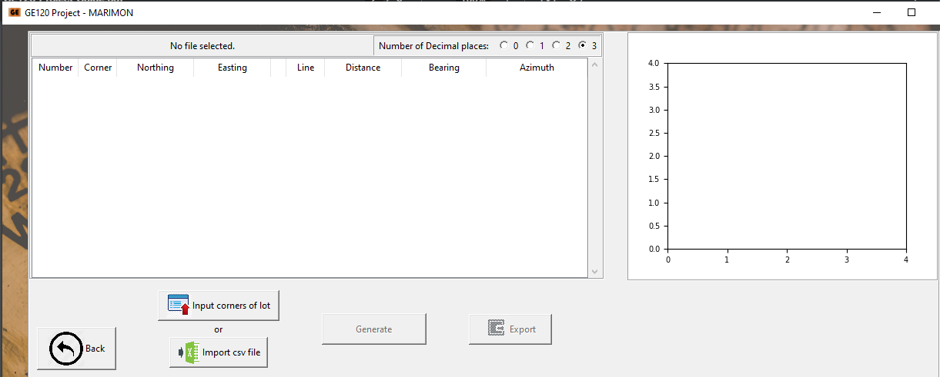
Sample Screenshots

Slide 9
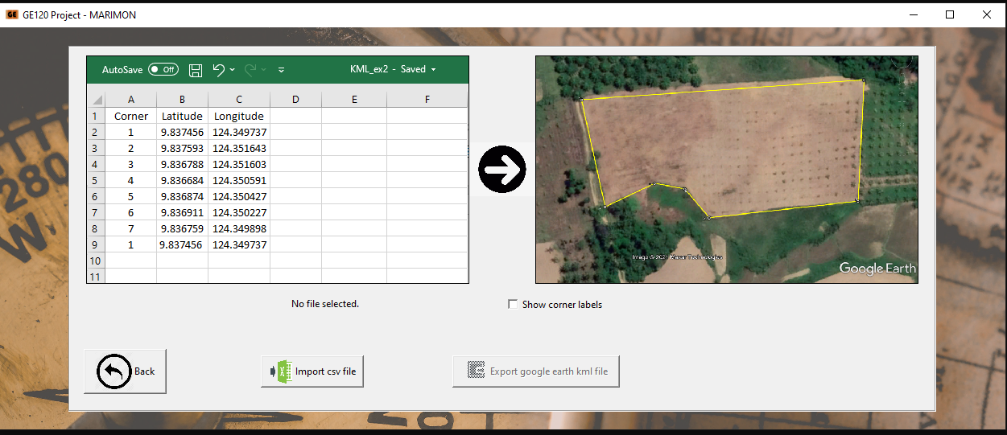
Sample Screenshots

Slide 10
Script run

Slide 11
References:
GE10 - Lecture 9 - Horizontal Position Computation by Traverse
GE10 - Lecture 13a - Simple Subdivision
Python Tkinter GUI Tutorial - https://www.youtube.com/watch?v=Aim_7fC-inw
Open Files Dialog Box - Python Tkinter GUI Tutorial #15 - https://www.youtube.com/watch?v=Aim_7fC-inw

Slide 12
References:
Python simplekml tutorial - https://www.youtube.com/results?search_query=simplekml
Treeview - Python Tkinter GUI Tutorial #116 - https://www.youtube.com/watch?v=YTqDYmfccQU
Scrollbar Tkinter - https://www.youtube.com/watch?v=0WafQCaok6g
Multilple Windows Tkinter - https://www.youtube.com/watch?v=bl5xdJ-b8GQ

